Slide 2
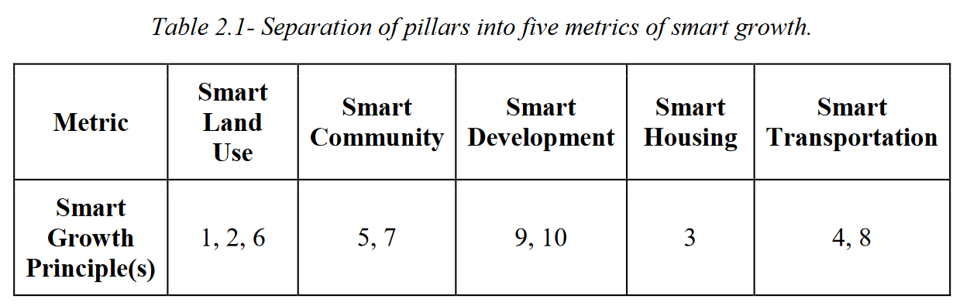
Smart Growth Index (SGI)
Even Weight
Output range of each metric: 0 - 20 → Summing each metric to score 100

Slide 3
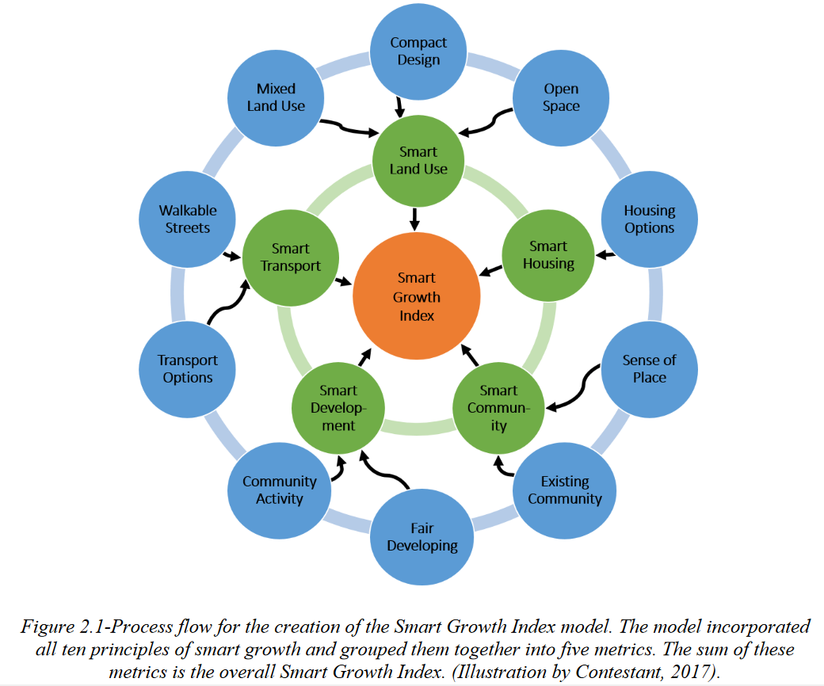

Slide 4
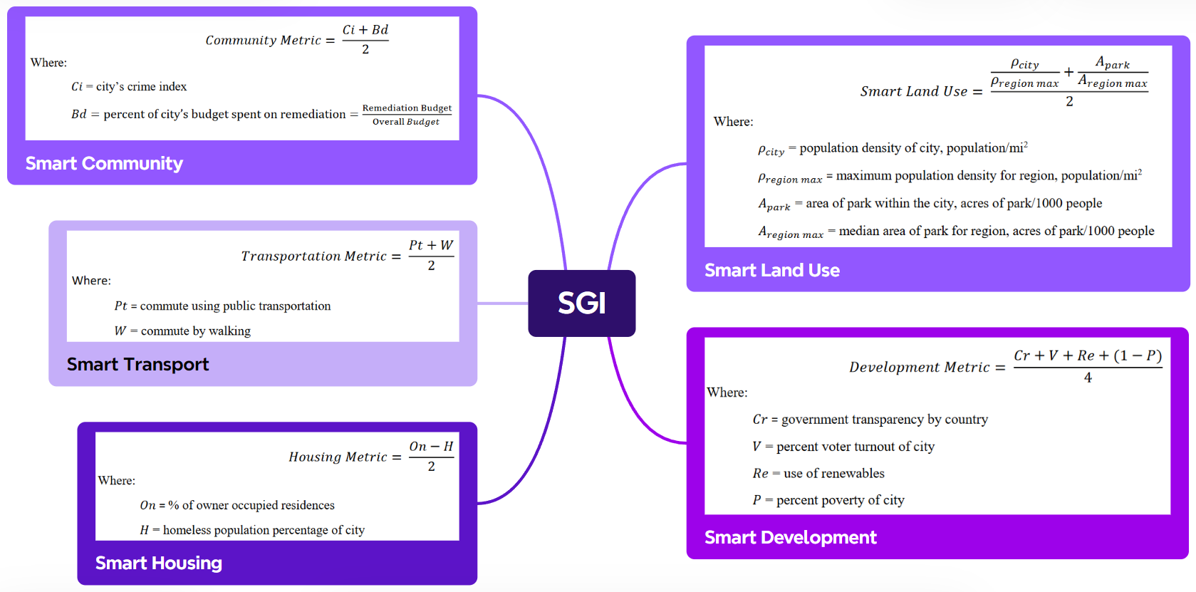

Slide 5
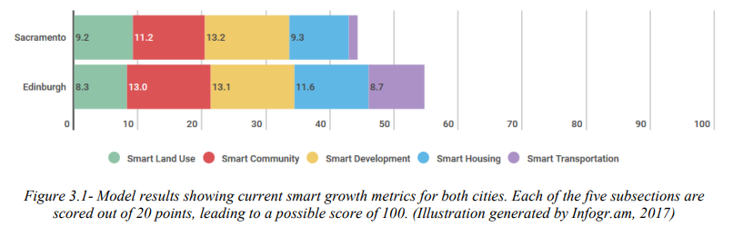
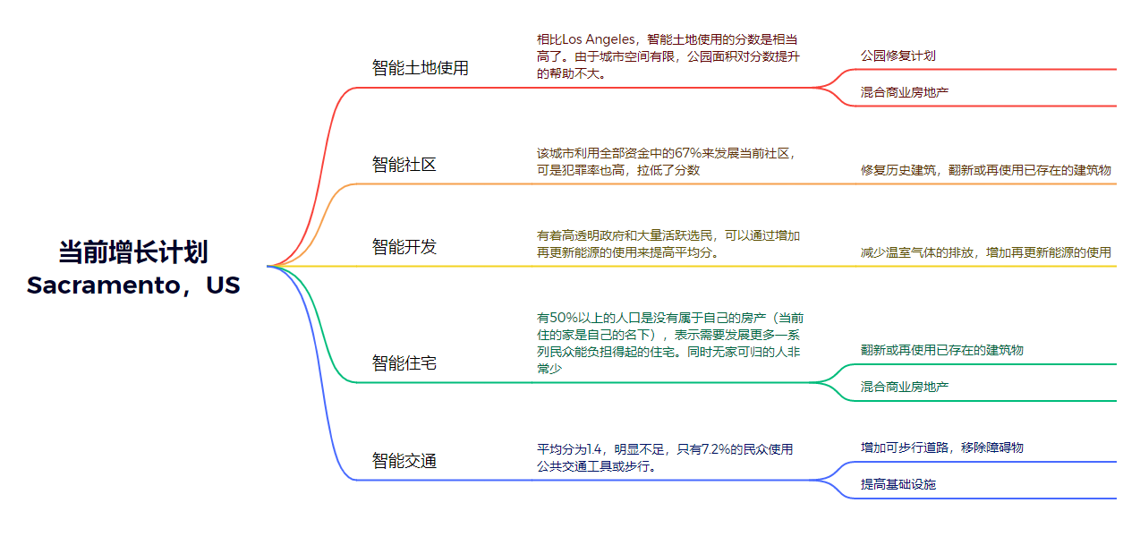

Slide 6
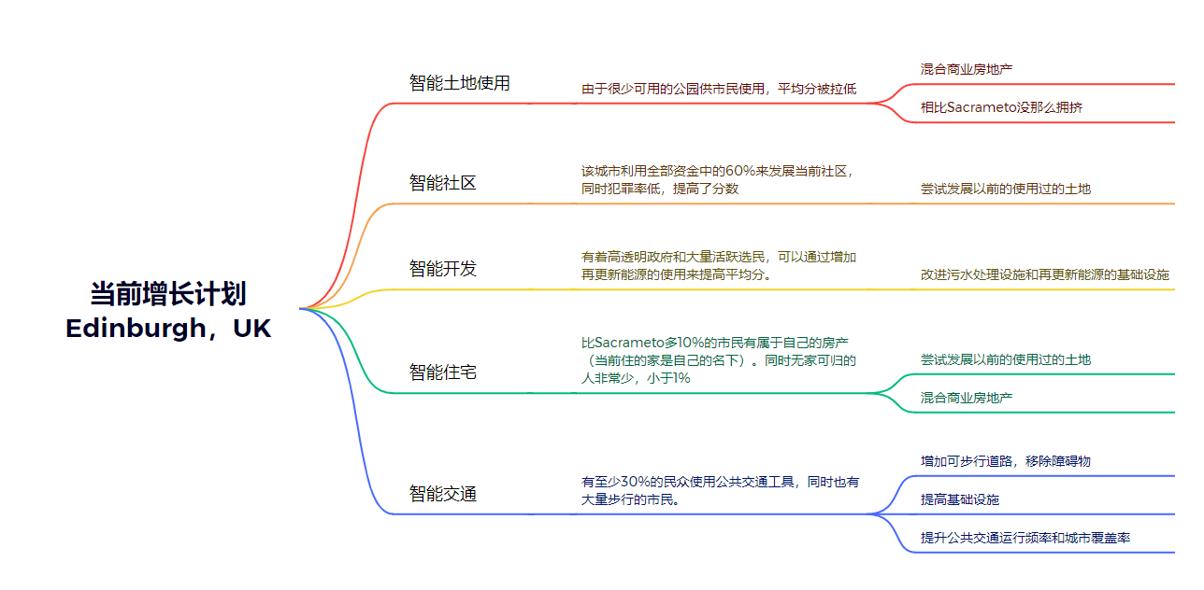

Slide 7
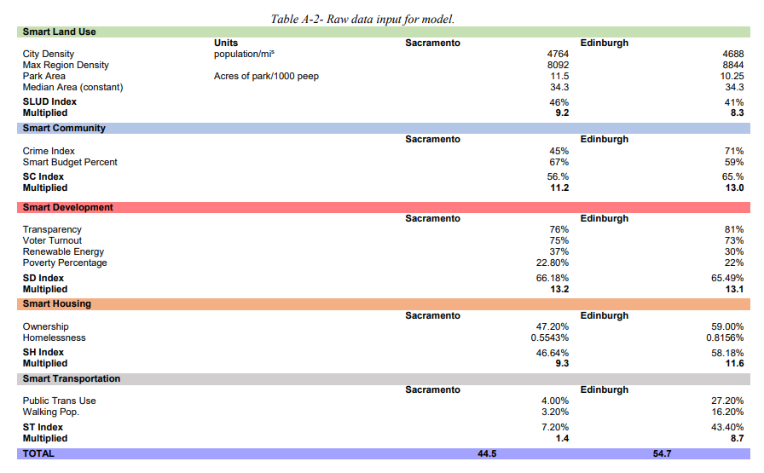

Slide 8
人口模型 2050
为了支持和应付50%的人口增长的情况，需要着力发展能带给市民便利性的设施。首先，通过发展公共交通设施，除了能带给民众方便，也能减少交通废气和温室气体的排放。土地利用和住宅也能促进智能城市的发展，并为民众提供便利。同时混合商业房地产能提高更多的工作机会、住宅选择和有一个更适合步行的社区。Sacramento会在公共交通使用率上面临困难。Edinburgh是一个全面的智能城市，当然他也有可以提升SGI的地方。经过一系列的分析，这个模型对于两个城市提升的指标都有很明确的方向。

Slide 9
Strengths of the Model
Measuring Tool: The Smart Growth Index serves as an effective measuring tool for developing cities, providing a benchmark for cities implementing smart growth planning.
Accessibility: Any city with general population data and growth plans can use this model to calculate their SGI, making it accessible to a wide range of cities.
Robust and Adaptable: The normalization of parameters to regional values enhances the model's robustness and adaptability to different regions.
Simple Data Requirements: The model relies on simple measurements that can be easily obtained by both developed and developing cities.
User-Friendly: The model's simplicity makes it user-friendly and easy to use for city planners and policymakers.

Slide 10
Weaknesses of the Model
Lack of Detail: The model's simplicity limits its ability to provide a detailed analysis of a city's smart growth plan.
Limited Metrics: Currently, only five metrics are used to calculate the SGI, which may not capture the full complexity of a city's growth plan.
Potential Manipulation: Cities could potentially manipulate their SGI by focusing on improving one facet of their growth plan, leading to a false sense of smart growth.
Equal Ranking Assumption: The assumption of equal ranking of metrics and measures may not be appropriate in all cases and could be further refined through research.
Sensitivity to Measure Changes: While most metrics respond proportionally to changes in measures, Smart Development has less sensitivity, possibly due to its complexity with multiple factors.

